Slide 1
How to setup SSH on VS Code for Sockeye
Afraz Arif Khan

Slide 2
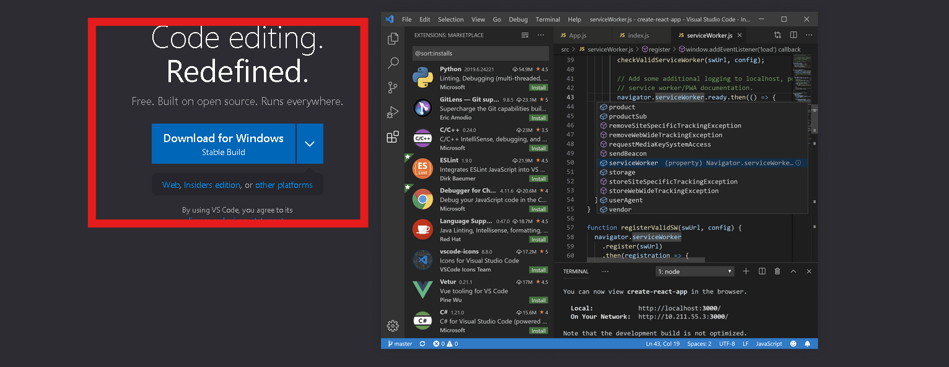
Download VS code from Microsoft
https://code.visualstudio.com/

Slide 3
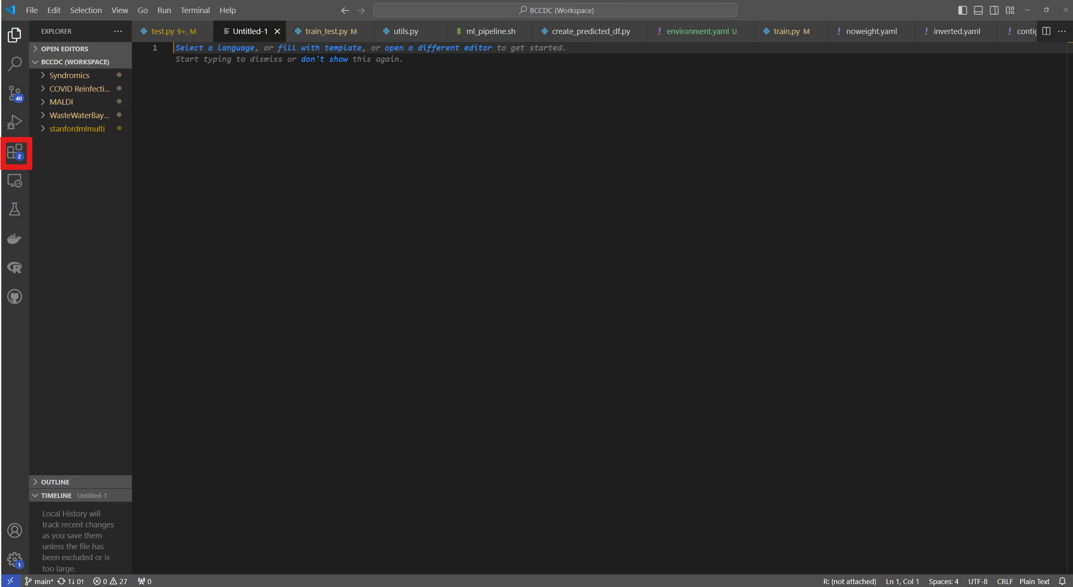
After Installation Launch VS code
Click on Extensions

Slide 4
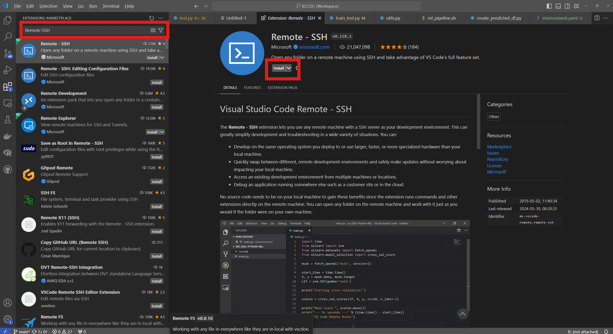
Download Remote SSH

Slide 5
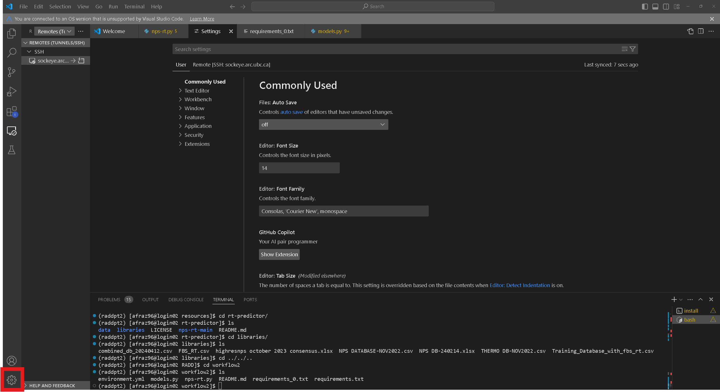
Before you try connecting fix the Terminal setting for Remote SSH

Slide 6
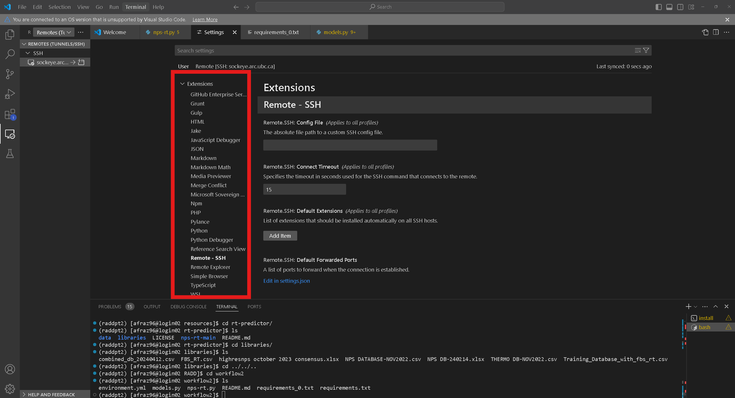
Scroll down to Remote SSH

Slide 7
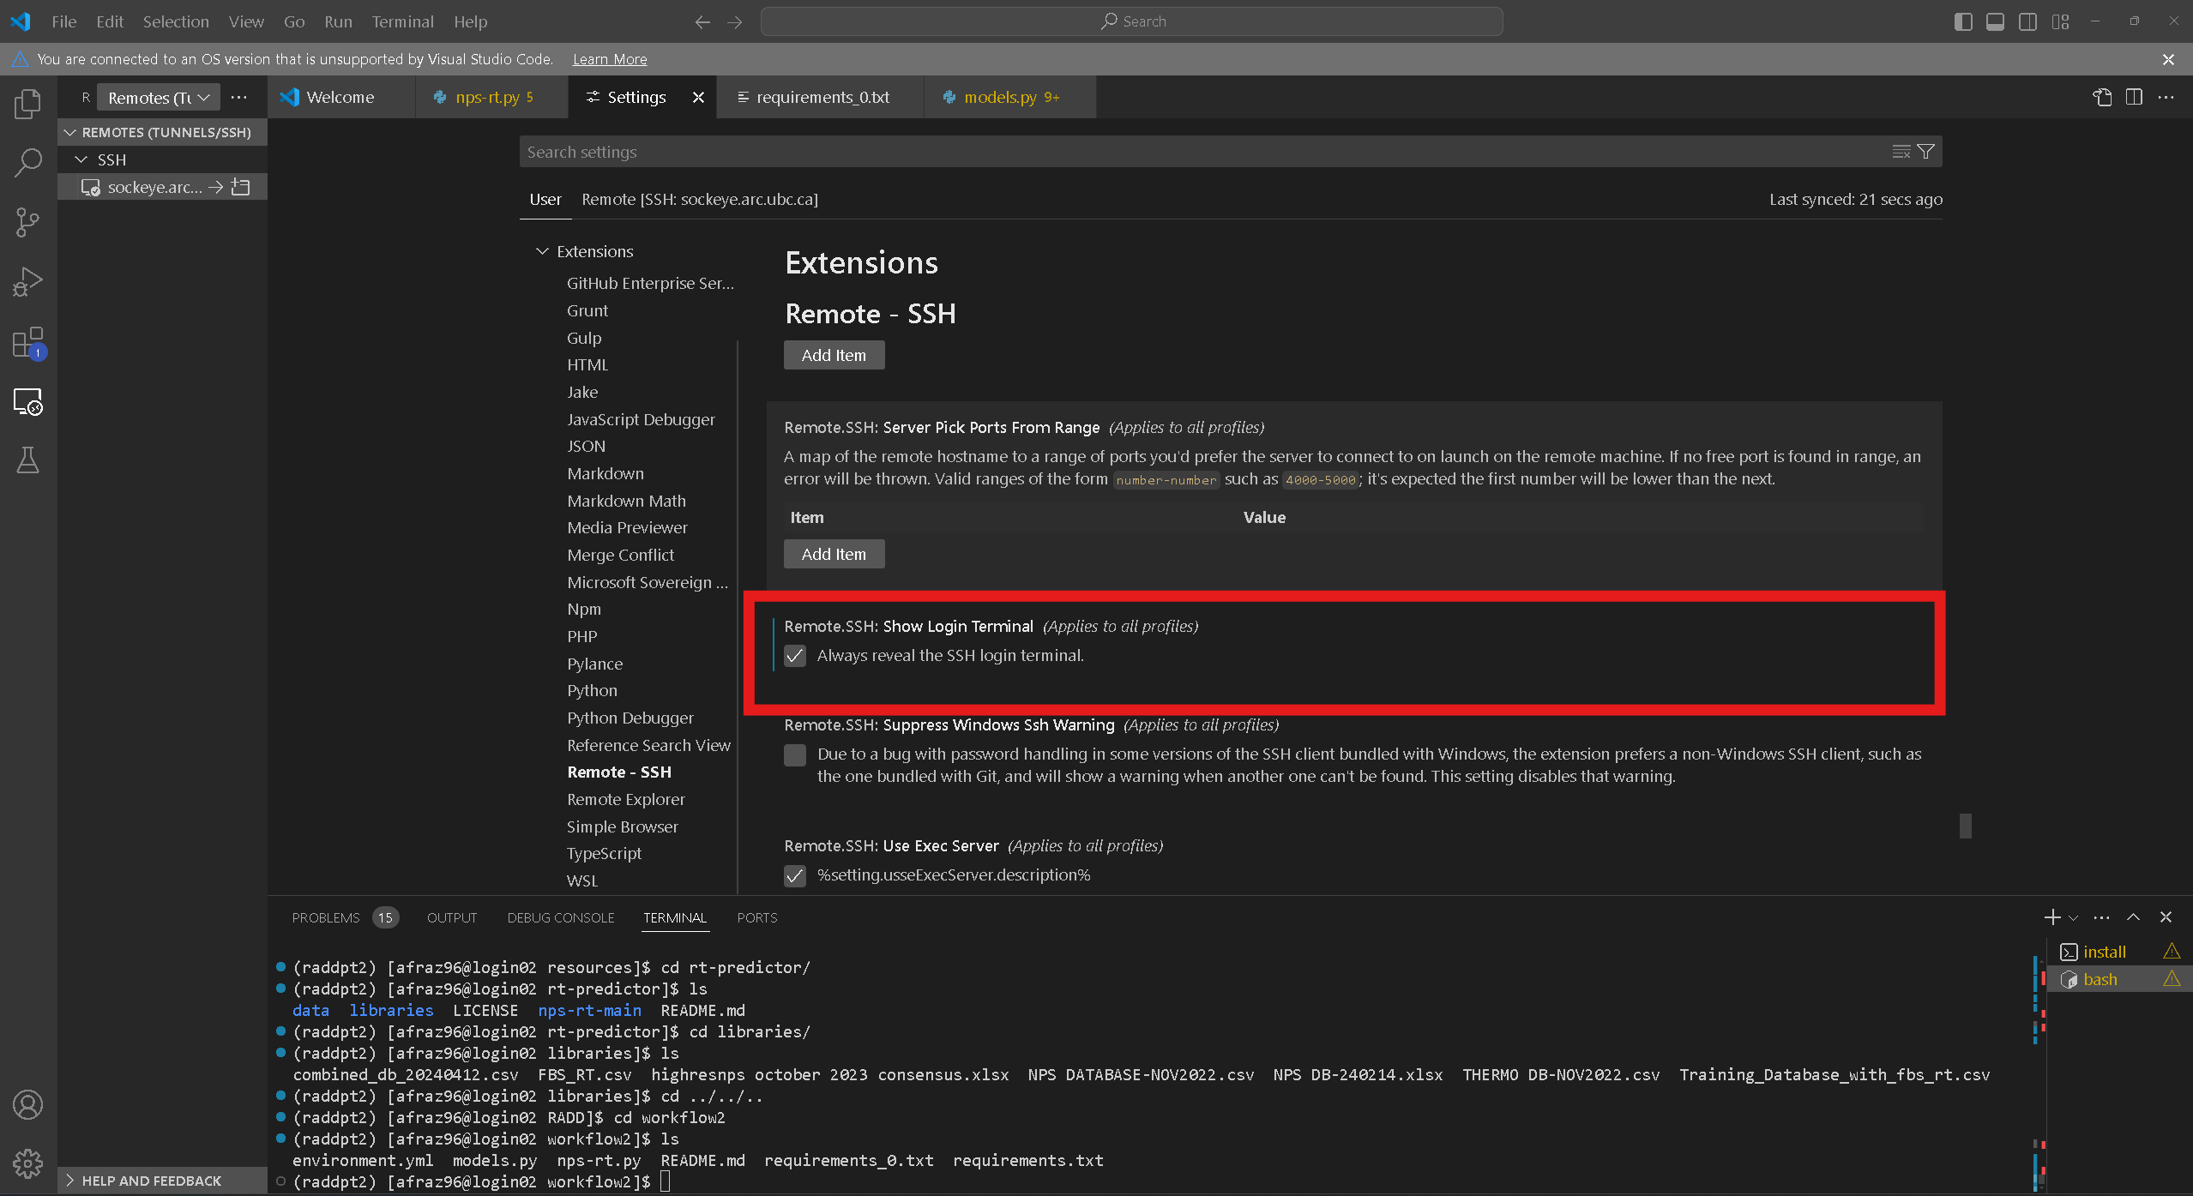
Enable remote login terminal

Slide 8
Try connecting to UBC Sockeye
Press F1 then the commands bar drops down
Type “Remote – SSH Add new SSH host”
“ssh cwl@sockeye.arc.ubc.ca”
It will ask you to choose Operating System, pick Linux
Then it will launch a terminal to do the Duo mobile step
Then it will add it permanently to your Remote Desktop

